Slide 1
HackRush 2024 LuminaRush: Real-time inferencing of ML workloads Computer Architecture
Jaidev Sanjay Khalane

Slide 2
Problem Statement
This project involves implementing a Convolutional Neural Network (CNN) to classify images from the CIFAR-10 dataset on an FPGA, specifically the Basys3 board. The primary goal is to achieve a minimum accuracy of 70% on the CIFAR-10 dataset. The choice of CNN architecture is left to the discretion of the implementer. However, the emphasis lies on maximising the model's accuracy and minimising the inference time by employing approximate computing and quantization. The use of FPGA technology provides an opportunity to optimise the microarchitecture for efficient parallel processing, which is crucial for real-time inference applications. Techniques like quantization can help reduce the computational requirements, while approximate computing can trade off precision for faster computations. The challenge lies in striking the right balance between accuracy and inference time while harnessing the capabilities of FPGA to achieve optimal performance on the CIFAR-10 image classification task. You may refer to the microarchitecture described in the "Resources (the first)." Kindly note that you cannot implement all the hardware on Basys3 since Basys3 needs more LUTs to accommodate all the hardware described in the paper provided.
Link: https://docs.google.com/document/d/15GreFsZB0dgByT2xkOEYmnkqpeaMSR0wU8XLdhBeeUc/edit#heading=h.1uhkw8fb0k1

Slide 3
Methodology
Model Training:
In order to reduce the model size, the weights were restricted to int8; 8 bit integers from float32.
This was done by quantisation.
If we directly quantise the weights to the model, we will lose the performance.
So, I used Quantization Aware Learning.

Slide 4
Quantization Aware Learning
Quantization-Aware Training (QAT) is a model optimization technique that computes scale factors during training to convert continuous values to discrete, and vice versa. QAT simulates low precision behavior in the forward pass, while the backward pass remains the same. QAT allows practitioners to apply quantization techniques without sacrificing accuracy, and it can help to improve model performance.
Ref: TF Docs

Slide 5
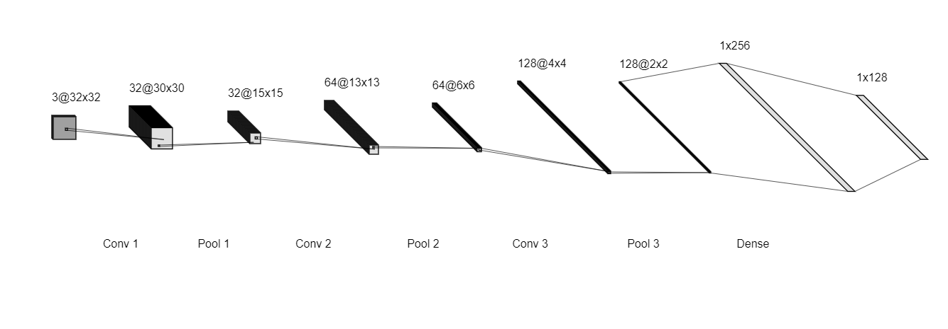
Model Architecture

Slide 6
Model Parameters and Results
Float model in Mb: 0.8702888488769531
Quantized model in Mb: 0.2286376953125
Storage on Basys 3: 1.8MB
Training Accuracy of the Quantized model: 0.9675
Baseline test accuracy: 0.6876999735832214
Quant test accuracy: 0.7235999703407288

Slide 7
Link to the Code
https://github.com/JaidevSK/LuminaRush-HackRush-2024/tree/main

Slide 8
Model on FPGA
Methodology:
I could use UART, but I wanted something different.
So, I have used the data input and output through the Pen Drive connected to the board and the address of the file will be given as input. The output for the 10 classes will be displayed by 4 bit LEDs.
By this, we can load more heavier weights on Pen Drive and possibly run heavier model.
I have also developed a more efficient implementation by the ability to perform post processing on our device.
Code: https://github.com/JaidevSK/LuminaRush-HackRush-2024/blob/main/cnn.v

Slide 9
Conclusion
Though this is the end of the Hackathon,
It may be the beginning of a new project
Thank You

